Slide 1
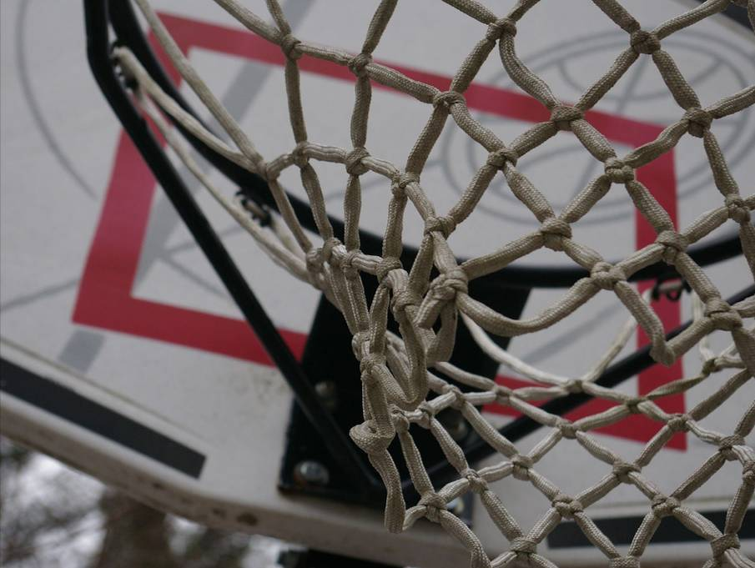
Math Basketball
Math 10 Cumulative Review

Slide 2
Math Basketball Rules
Raise your hand to answer a question.
A correct answer scores 1 point and a basketball shot for bonus points.
An incorrect answer allows the other team to take a shot for penalty points.
Points are given according to the student's distance from the basket.
You can’t answer 2 questions in a row.
Notes:
Split the class up into teams. Wait for at least one hand per team before selecting a response. I typically have lines set up for 1, 2 or 3 point shots.

Slide 3
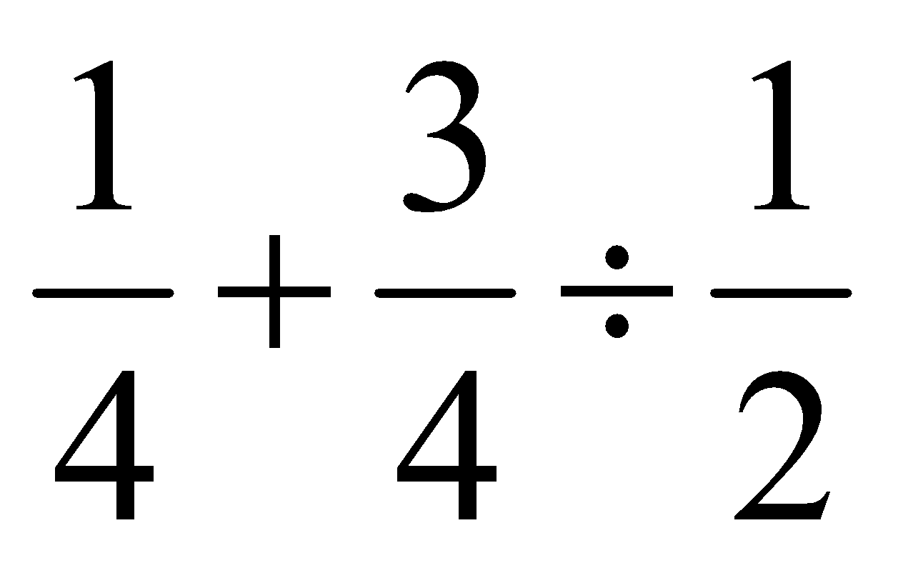
Evaluate this expression
Outcome: Prior Knowledge
Notes:
A order of operations warmup : ¼ + ¾*2/1 = ¼ + 6/4 = 7/4

Slide 4
What is the length of this toothpick?
Outcome: M01
Notes:
2.5 inches

Slide 5
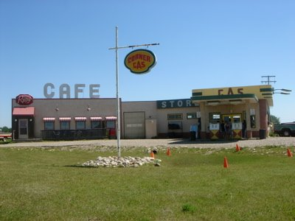
Name this fictional Canadian town
Notes:
Dog River from the TV Show Corner Gas

Slide 6
How many inches are in 5 feet?
Outcome: M02
Notes:
12in/ft * 5ft = 60 inches

Slide 7
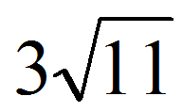
What is the following mixed radical written as an entire radical?
Outcome: AN02
Notes:
sqrt(99)

Slide 8
This is the flag of which province?
Notes:
Manitoba

Slide 9
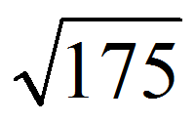
What is this radical in simplest form?
Outcome: AN02
Notes:
5sqrt(7)

Slide 10
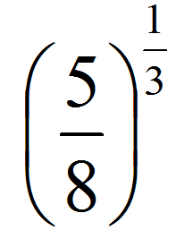
What is this power expressed as a radical?
Outcome: AN03
Notes:
Cuberoot(5)/2

Slide 11
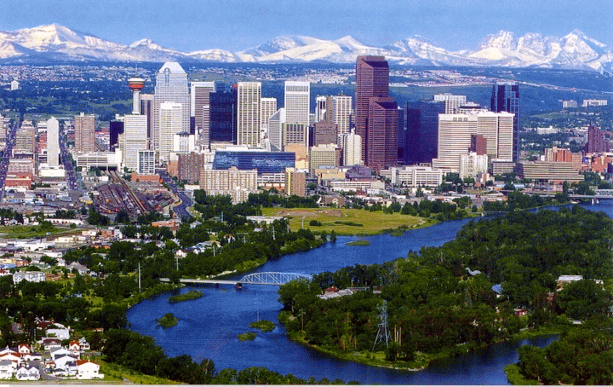
Name this Canadian city
Notes:
Calgary

Slide 12
Factor this trinomial
3x² + 7x - 6
Outcome: AN05
Notes:
(3x - 2)(x + 3)

Slide 13
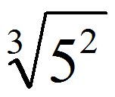
What is this radical expressed as a power?
Outcome: AN03
Notes:
5^(2/3)

Slide 14
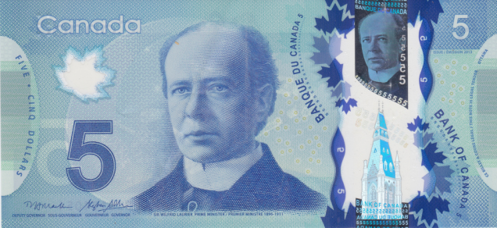
Who is this guy?
Notes:
Sir Wilfred Laurier

Slide 15
What are two trigonometric expressions that can be used to find the missing side?
57°
8
33°
x
Outcome: M04
Notes:
x= 8cos(33) and x = 8sin(57)

Slide 16
What type of special polynomial is the following expression?
9x⁴ - 49
Outcome: AN05
Notes:
Difference of squares

Slide 17
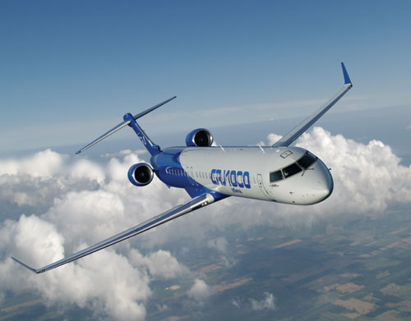
What Canadian company makes this plane?
Notes:
Bombardier

Slide 18
Fill in the missing values so that the ordered pairs do not represent a function.
{(2,8), (6,10), (10,12), (__, __)}
Outcome: RF02
Notes:
Any ordered pair with an x-value of 3, 5 or 7 will make this not a function.

Slide 19
Fill in the missing values so that the ordered pairs represent a linear relation.
{(2,8), (6,10), (10,12), (__, __)}
Outcome: RF04
Notes:
(14,14) or any point that falls on the line y=1/2x+7

Slide 20
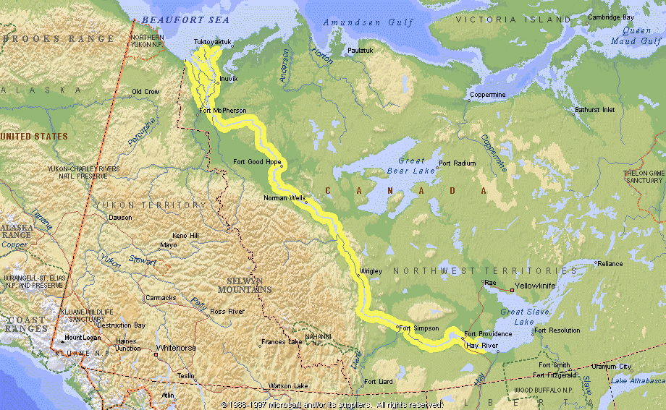
What is the longest river in Canadian?
Notes:
The Mackenzie River is the longest river in Canada covering a distance of around 1800 km.

Slide 21
Rewrite this function in general form.
2y = 3x + 7
Outcome: RF06
Notes:
General Form: 3x – 2y + 7 = 0

Slide 22
Write a linear equation to represent the pattern in the given table of values.
Time (s) | 0 | 1 | 2 | 3
Height (m) | 3 | 4.5 | 6 | 7.5
Outcome: RF04
Notes:
y= 3/2 x + 3 or y = 1.5x + 3

Slide 23
What is the name of the Premier of Nova Scotia?
Notes:
Stephen McNeil was elected Premier on Oct. 8, 2013.

Slide 24
What are the x and y-intercepts of the graph of the following equation.
2x – 3y = 12
Outcome: RF05
Notes:
Y-intercept: (0,-4) and x-intercept: (6,0)

Slide 25
The following lines are parallel. What is a possible value of n?
nx + 12y – 2 = 0
3x + ny + 6 = 0
Outcome: RF06
Notes:
n/12 = 3/n so n = 6 or -6
You can demonstrate this really well by plugging these equations in desmos.com and adding a slider for n.

Slide 26
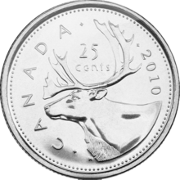
What animal is typically on the reverse of a Canadian quarter?
Notes:
A caribou

Slide 27
What is the equation of the line that passes through the following points?
(-2,6) and (4,-6)
Outcome: RF07
Notes:
Y = -2x + 2

Slide 28
What is the midpoint of the line segment with the two endpoints below?
(-2,6)
(4,-6)
Outcome: RF08
Notes:
Midpoint ((-2+4)/2, (6+(-6))/2) = (1,0)

Slide 29
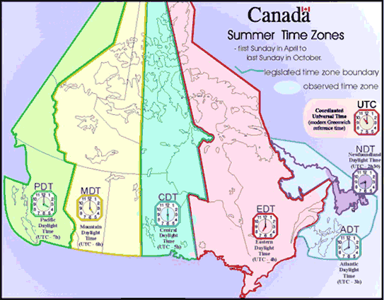
How many time zones are in Canada?
Notes:
There are six.

Slide 30
Given f(x) = 7 – 3x,
calculate f(-5)
Outcome: RF09
Notes:
F(-5) = 7-3(-5) = 22

Slide 31
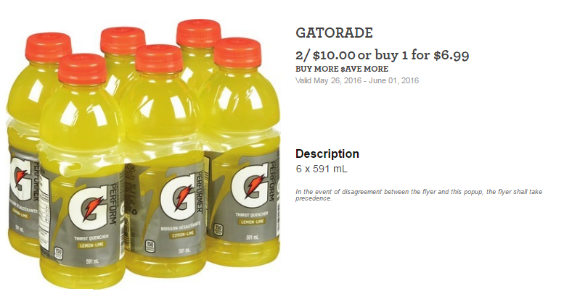
What is unit price of Gatorade ($/Litre)?
Outcome: FM01
Notes:
2x6x591=7.092 L, $10/7.092 = $1.41 per L

Slide 32
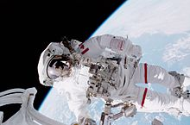
What is the name of the first Canadian to walk in space?
Notes:
Chris Hadfield

